Slide 1
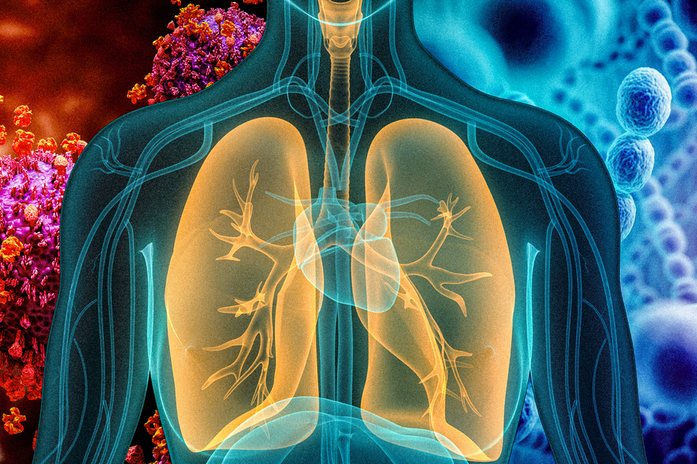
PNEUMONIA DIGNOSIS

Slide 2
TABLE OF CONTENTS
01
Introduction
02
Data Collection
03
Problems we faced
04
Solution to solve this problems
05
Our code
06
conclusion

Slide 3
INTRODUCTION
Pneumonia is an infection that inflames the air sacs in one or both lungs, making it difficult to breathe. The air sacs fill with fluid or pus, hindering oxygen exchange and causing various symptoms. Various organisms can cause pneumonia, including bacteria, viruses, and fungi.
Causes:
Bacteria: The most common cause.
Viruses: Responsible for about one-third of cases.
Fungi: Less common.
Symptoms:
Fever
Cough (with or without mucus)
Shortness of breath
Chest pain
Chills
Muscle aches
Fatigue
Confusion (in older adults)
Diagnosis:
Physical examination
Chest X-ray
Blood tests
Sputum test to identify the causative organism
So we decided to make a simple website to detect whether the chest x-ray that the user entered has a pneumonia disease or not

Slide 4
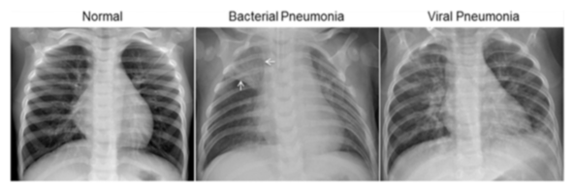
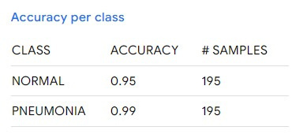
OUR DATA SET
Our source for the data set of Chest X-Ray Images (Pneumonia) is from Kaggle website.
This data set contains 5,863 images ,2 categories(NORMAL(1341),PNEUMONIA(3875))
and this is its LINK
https://www.kaggle.com/datasets/paultimothymooney/chest-xray-pneumonia
accuracy = (number of correct predictions) / (number of total predictions)

Slide 5

PROBLEMS
first:Sometimes we faced problems like if we enter data of 100 image of both Normal and Pneumonia the system can read only 80 of them and thus there is an error of 20%.
second:data quality
Ensuring the quality of medical imaging data is crucial. Variability in image resolution, noise, and artifacts can impact the model's performance.
third: overfitting
With complex machine learning models, there is a risk of overfitting, where the model performs well on training data but fails to generalize to new, unseen data.
fourth: transferability
The model's ability to generalize across different populations or datasets is essential for its practical utility in diverse healthcare settings.
fifth:Integration with Clinical Workflow
Implementing a machine learning model into clinical practice requires seamless integration with existing workflows and diagnostic processes, which can be complex and time-consuming.
\

Slide 6
SOLUTION TO SOLVE PROBLEMS
We increased our data set to 5,863 so we get good predictive results with our model.
Generally the larger the number, the better your model will learn to predict the data.
Data Quality:
Apply pre-processing techniques to standardize image resolution and reduce noise.
Collaborate with radiologists to ensure the dataset's accuracy and reliability.
Overfitting:
Employ techniques like dropout, regularization, and cross-validation to prevent overfitting.
Consider using simpler models or ensemble methods
Transferability:
Use transfer learning with pre-trained models on large datasets to improve generalization.
Validate the model's performance on diverse datasets representative of different populations.
Integration with Clinical Workflow:
Involve healthcare professionals in the development process to ensure practicality.
Develop user-friendly interfaces for seamless integration into existing workflows.

Slide 7
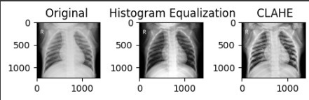
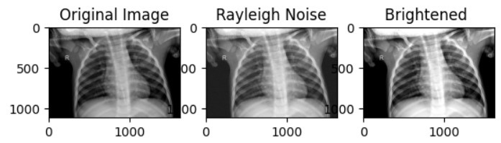
IMAGE ENHANCEMENT
Histogram Equalization
CLAHE
Rayleigh Noise
Brightened

Slide 8
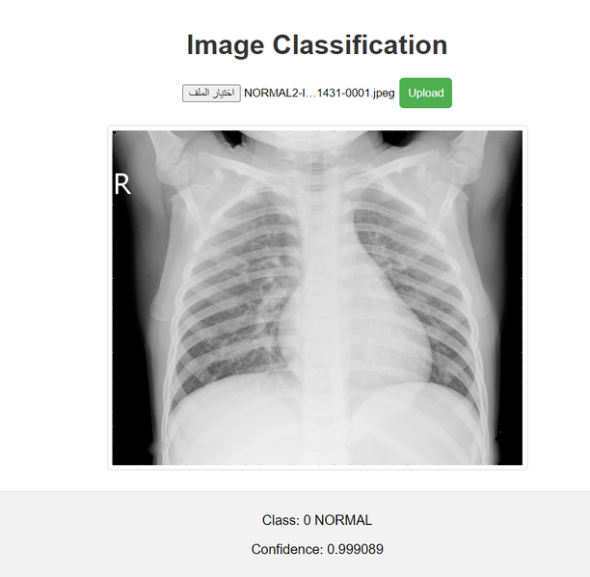
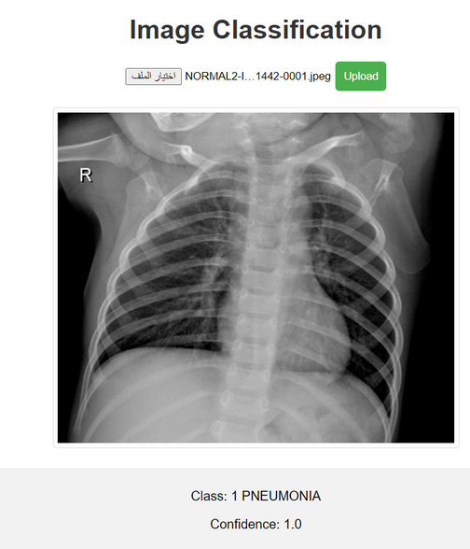
OUTPUT OF THE MODEL

Slide 9
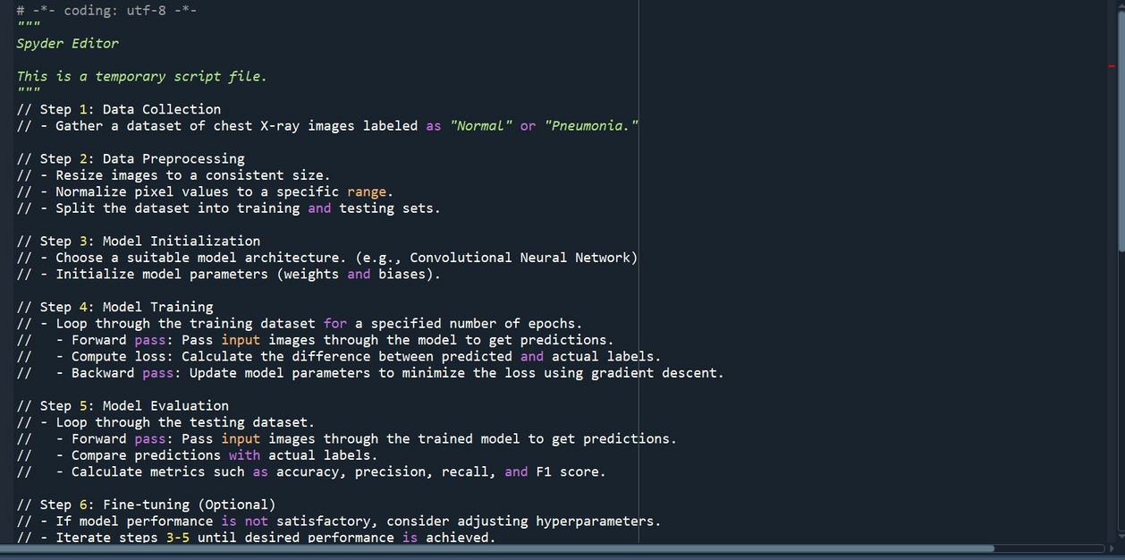
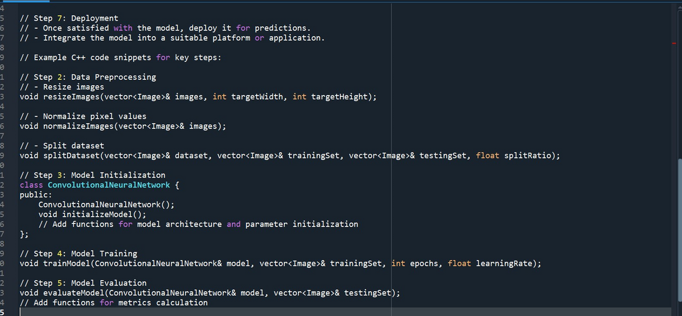
PNEUMONIA DETECTION ALGORITHM

Slide 10
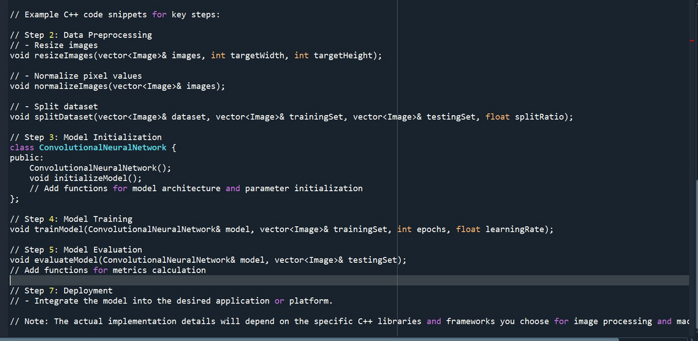

Slide 11
OUR MODEL
EPOCHS: 20
LEARNING RATE: 0.01
BATCH SIZE: 16
IMAGE SIZE: 224X224 PIXELS
DATA AUGMENTATION: APPLY RANDOM HORIZONTAL FLIPS AND ROTATIONS DURING TRAINING.
VALIDATION SPLIT: 85% TRAINING, 15% VALIDATION
MODEL ARCHITECTURE: USE A PRE-TRAINED CNN
LOSS FUNCTION: BINARY CROSSENTROPY
METRICS: ACCURACY, PRECISION, RECALL, F1 SCORE
OPTIMIZER: ADAM
WEIGHT INITIALIZATION: GLOROT INITIALIZATION

Slide 12
CONCLUSION
IN CONCLUSION, THE DEVELOPMENT AND IMPLEMENTATION OF OUR PNEUMONIA DETECTION MODEL ON THE WEBSITE REPRESENT A SIGNIFICANT STEP FORWARD IN LEVERAGING MACHINE LEARNING FOR MEDICAL DIAGNOSIS. THE WEBSITE EFFECTIVELY PROCESSES CHEST X-RAY IMAGES, DISTINGUISHING BETWEEN NORMAL AND PNEUMONIA CASES WITH PROMISING ACCURACY.
OVERALL, THE WEBSITE STANDS AS A TESTAMENT TO THE SYNERGY BETWEEN TECHNOLOGY AND HEALTHCARE, OFFERING A USER-FRIENDLY INTERFACE FOR ACCURATE AND TIMELY IDENTIFICATION OF PNEUMONIA CASES, ULTIMATELY CONTRIBUTING TO ENHANCED PATIENT OUTCOMES.

Slide 13
MADE BY:
Rawan Ebrahem
Rodan Mohamed
Salwa Ali
Ali Araby
Yara Fatouh

